Slide 1

EXPLAIN
15 MIN
HOMEWORK REVIEW
CORRECTION / DEMO

Slide 2
CHAPTER 1
PYTHON to JS
PART 3
OBJECTS

Slide 3
{ key: value, key: value }
Python dictionaries are objects in JavaScript
But more powerful !!

Slide 4
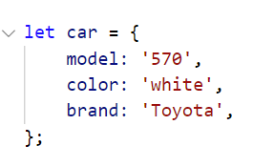
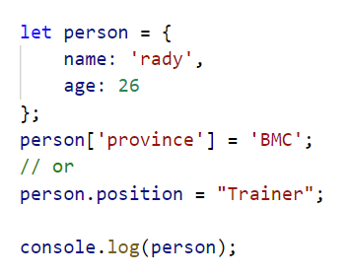
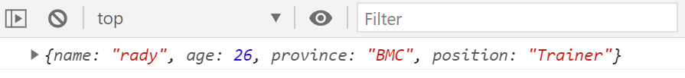
EXPLAIN
An object is declared or dynamically created
15 MIN
Code declared
Dynamically created
Output

Slide 5
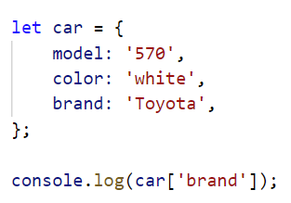
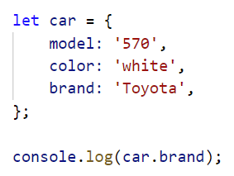
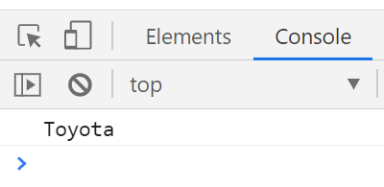
EXPLAIN
An object attributes can be accessed either
Using [] or .
15 MIN
Access object attributes using []
Access object attributes using
.
Output

Slide 6
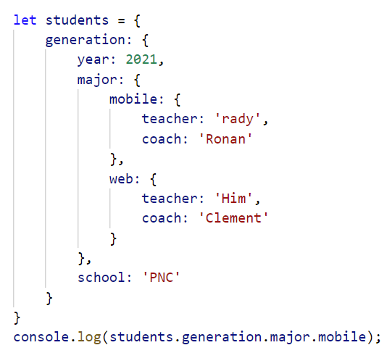
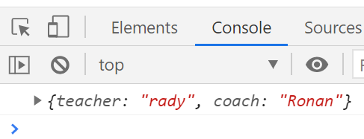
EXPLAIN
An object can be composed of other objects
15 MIN
Output

Slide 7

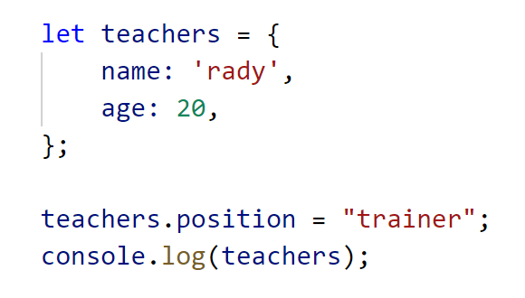



What this code will print ?
15 MIN
A.
B.
C.
D.
undefined
Notes:
a

Slide 8
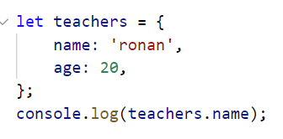

What this code will print ?
15 MIN
A.
B.
C.
D.
ronan
20
name
undefined
Notes:
a

Slide 9
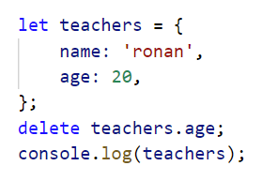




What this code will print ?
15 MIN
A.
C.
D.
B.
undefined
Notes:
c

Slide 10
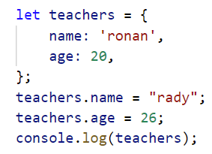



What this code will print ?
15 MIN
A.
B.
C.
D.
undefined
Notes:
a

Slide 11
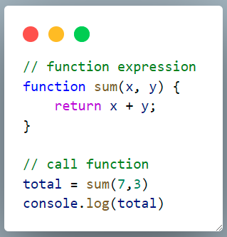
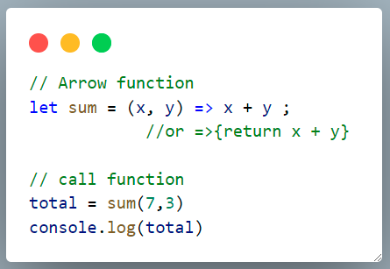
EXPLAIN
15 MIN
2 ways to declare a function
Normal function
Arrow function

Slide 12
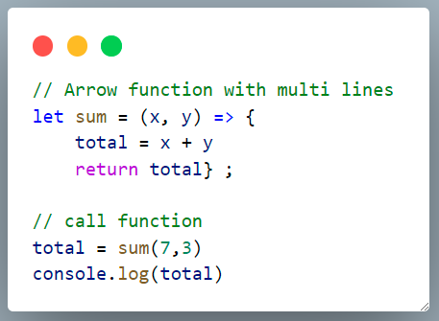
EXPLAIN
15 MIN
Arrow function with multi lines

Slide 13
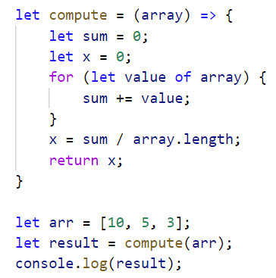

What this code will print ?
15 MIN
A.
B.
C.
D.
5
7.75
6
undefined
Notes:
c

Slide 14
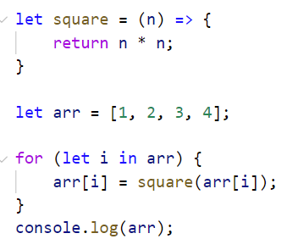

What this code will print ?
15 MIN
A.
B.
C.
D.
[1, 4, 9, 16]
[2, 4, 6, 8]
[1, 2, 3, 4]
undefined
Notes:
a

Slide 15
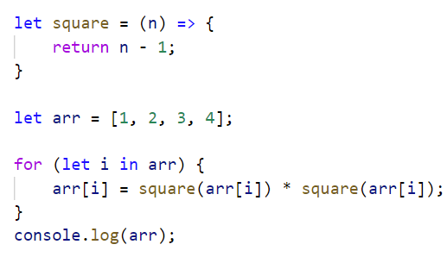

What this code will print ?
15 MIN
A.
B.
C.
D.
[0, 1, 2, 3]
[2, 4, 6, 8]
[0, 1, 4, 9]
undefined
Notes:
c

Slide 16
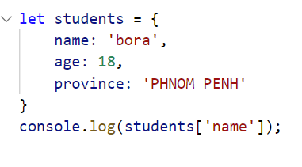

What this code will print ?
15 MIN
A.
B.
C.
D.
bora
18
PHNOM PENH
undefined
Notes:
a

Slide 17
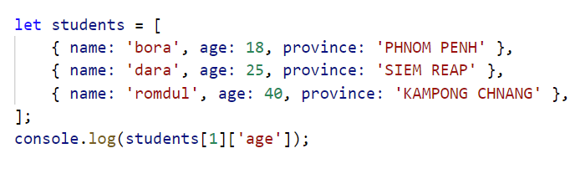

What this code will print ?
15 MIN
A.
B.
C.
D.
25
18
40
undefined
Notes:
a

Slide 18
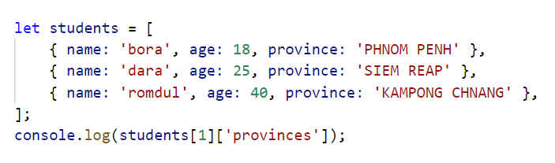


What this code will print ?
15 MIN
A.
B.
C.
D.
25
18
40
SIEM REAP
Notes:
d

Slide 19
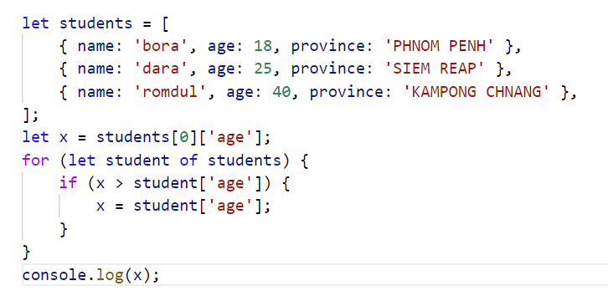

What this code will print ?
15 MIN
A.
B.
C.
D.
25
18
40
undefined
Notes:
b

Slide 20
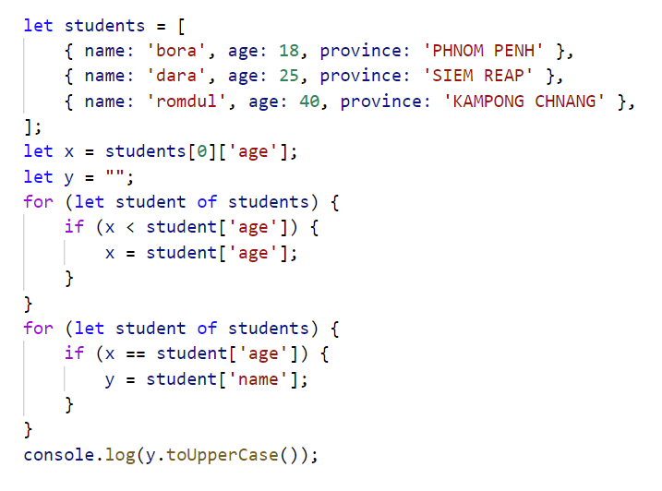

What this code will print ?
15 MIN
A.
B.
C.
D.
DARA
ROMDUL
bora
undefined
Notes:
b

Slide 21
MANIPULATE
30 MIN
EXERCICE
Read the instructions
Submit your script.js
Notes:
They open the activity 2 and complete the word
ANSWERS
Q1 : elements are organized as containers (div contain p and buttons…)
Q2 : the identifiers can be the class (some items have the same class example : title) or the id (an id is unique)
They are used in CSS for the style, but they can also be used by javascript
Q3 : if you delete a container, everything that is contained by it is deleted too.
------------------------------------------
Show the html code in the dev tools, and ask what are all the class for.
-> they are used as reference so that css may use it, but also js !
-> build a parallel between css and js : placement in the Document, but also reference to objects.
-> end by describing the content of the page in order of DOM hierarchy
•Document
•header/body
• each header/body have their div, paragraphs
• each div contains paragraph or Images…

